Slide 1
Geosynchronous Satellite
By:Priyanshi Jindal
Roll No:40

Slide 2
Definition of Geosynchronous Satellite
Satellite that remains in geosynchronous orbit around our planet.
It is a communication satellite that has an orbital period same as the period of rotation of the earth.
Orbital period-23 hours 56 minutes 4 seconds.
Geosynchronous Orbit-
The orbits where geosynchronous satellites revolve are known as geosynchronous orbit.
Geosynchronous Orbit can have any inclination
Located above 35,786 km above earth’s equator

Slide 3
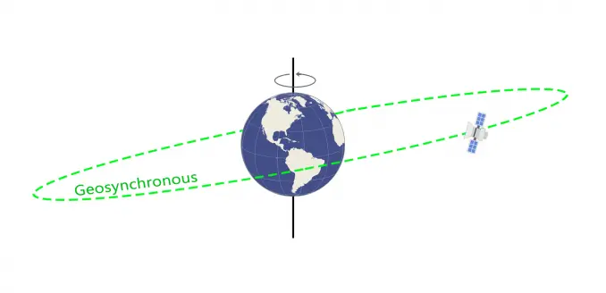
Geosynchronous Orbit

Slide 4
Geostationary Orbit
A special case of Geosynchronous satellite is geostationary satellite.
Geosynchronous Satellite-
When a satellite is placed directly above the equator with a circular orbit and angular velocity identical to that of earth,is known as geostationary Satellite.
Such satellite appears to be stationary above a particular point which is due to its synchronization.
Irrespective of their orbits both satellites are related.

Slide 5
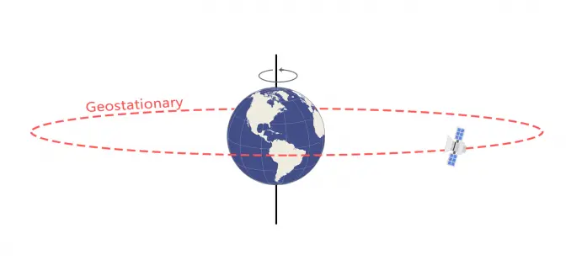
Geostationary Orbit

Slide 6
Benefits of Geosynchronous Satellite
1.As it is at greater height, it covers larger geographical area. Hence only 3 satellites are required to cover the entire Earth.
2.Satellites are visible for 24 hours continuously from single fixed location on the Earth.
3. Expensive tracking equipment is not required at the earth stations.
4.Switching from one geosynchronous satellite to another as they orbit overhead is not necessary. Consequently, there are no transmission breaks due to switching times.

Slide 7
Issues with geosynchronous Satellite
➨It is not suitable for point to point applications requiring time critical applications such as real time voice, video etc.
➨ It is difficult to broadcast near the polar region.
➨Due to longer transmission distance, the received signal is very weak. This requires better LNA (Low Noise Amplifier) and also advanced signal processing algorithms in the satellite modem. This increases cost of the ground station equipments.
➨It provides poor coverage at higher latitude places usually greater than 77 degrees.

Slide 8
Applications
It is ideal for broadcasting and multi-point distribution applications.
It is ideal for communication since it is always above the surface of the earth.
Another common use for GEO satellites is for signals intelligence (SIGINT) where these satellites can be used for generating intelligence for military and defense applications.
One of the most well-known use cases of GEO satellites is the satellite-based navigation system, which is used to localize a radio receiving terminal, also referred to as the global positioning system (GPS)

Slide 9
Geosynchronous Satellite Maintenance
The popularity of the GEO real estate, the region above the equator has become congested with satellites.
Due to the increased collision risk, and the relative importance of these satellites for communication and navigation systems, geosynchronous orbit maintenance has become an increasingly important issue.
These satellites maneuver frequently and require the ability to detect unknown maneuvers for target satellites and to allow those satellites to recover an accurate orbit.
Studies have been used to determine if angles from ground-based optical tracking to detect maneuvers and recover orbits can be used

Slide 10
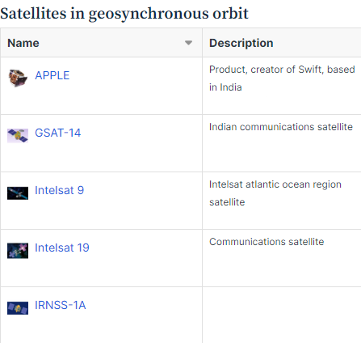
Satellites in Geosynchronous Orbit

Slide 11
References
1.ScienceDaily. https://www.sciencedaily.com/terms/geosynchronous_orbit.htm
2.The Economic Times. https://economictimes.indiatimes.com/
3.Geosynchronous vs Geostationary Orbits - GIS Geography. GIS Geography. https://gisgeography.com/geosynchronous-geostationary-orbits/

